Slide 1

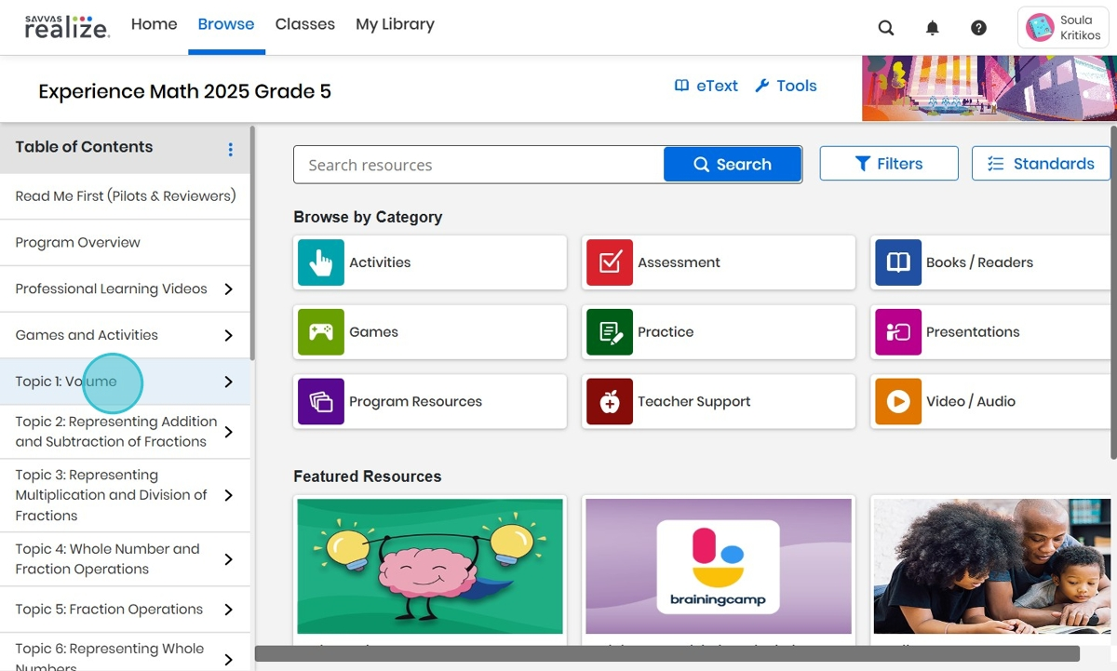
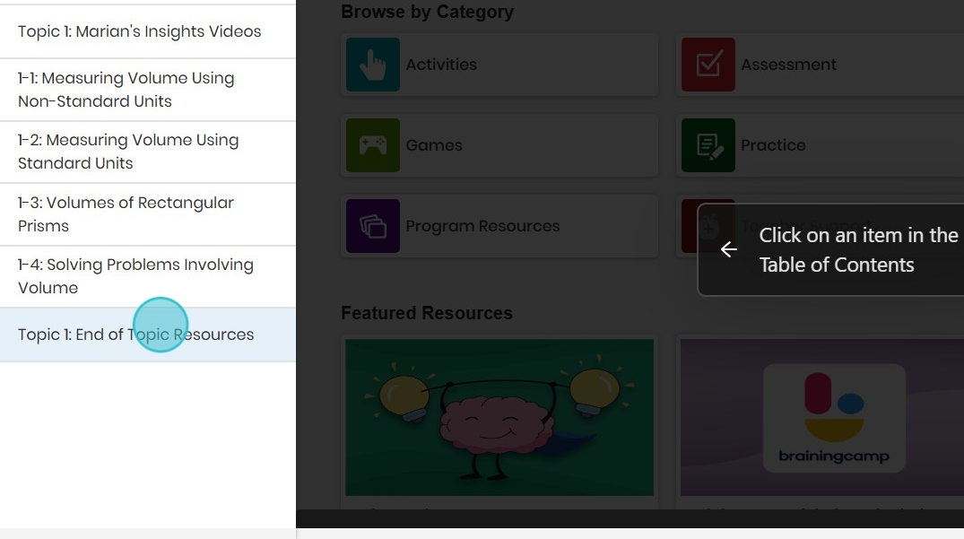
Adding Content
to Playlists
Steps to Success:
Navigate to your Experience Math dashboard. Click on your desired Topic in the Table of
Contents to find activities to add to your Playlist.
2.This example will use an End of Topic activity. Click on End of Topic Resources.

Slide 2
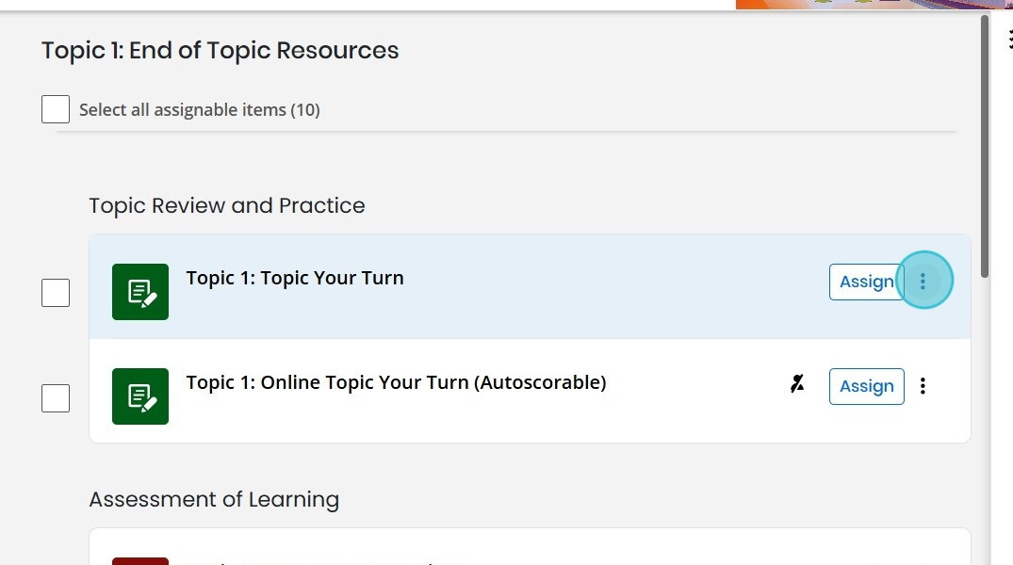
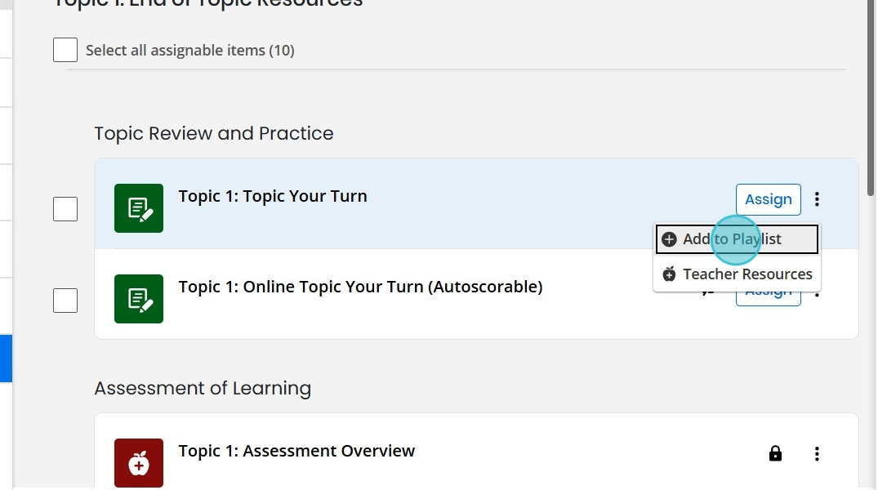
3. Scroll down to your desired activity, and click on the 3 dots beside the activity.
4. Click on Add to Playlist.

Slide 3
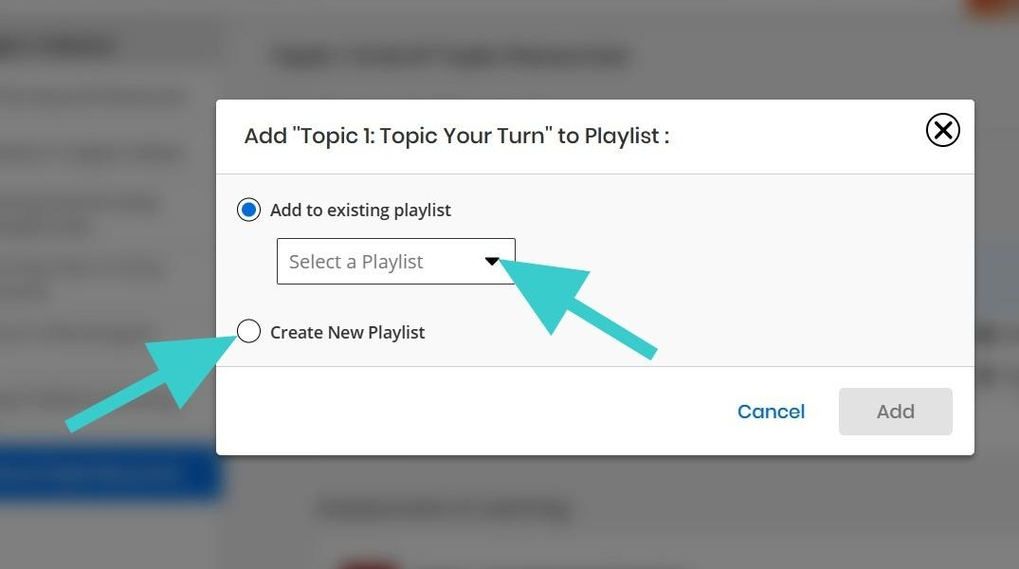
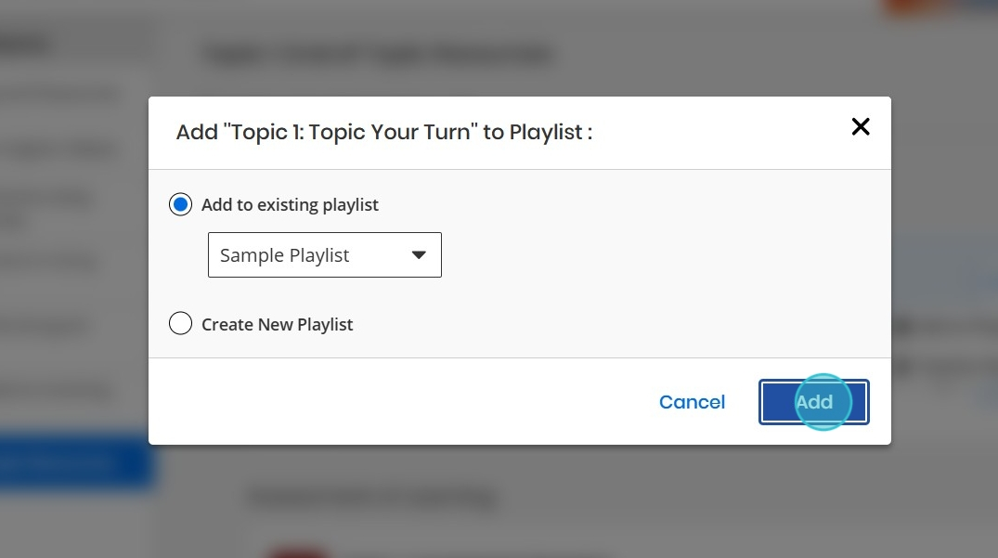
5. A pop-up will appear. You will be given 2 options to choose from for selecting a Playlist.
Option 1: You can click the arrow beside Add to existing playlist, to choose a previously
created Playlist.
Option 2: Click on Create New Playlist. If you choose this option, you must first name your
Playlist before adding content.
6. This example uses the existing playlist 'Sample Playlist'. Once you are finished, click on Add.

Slide 4
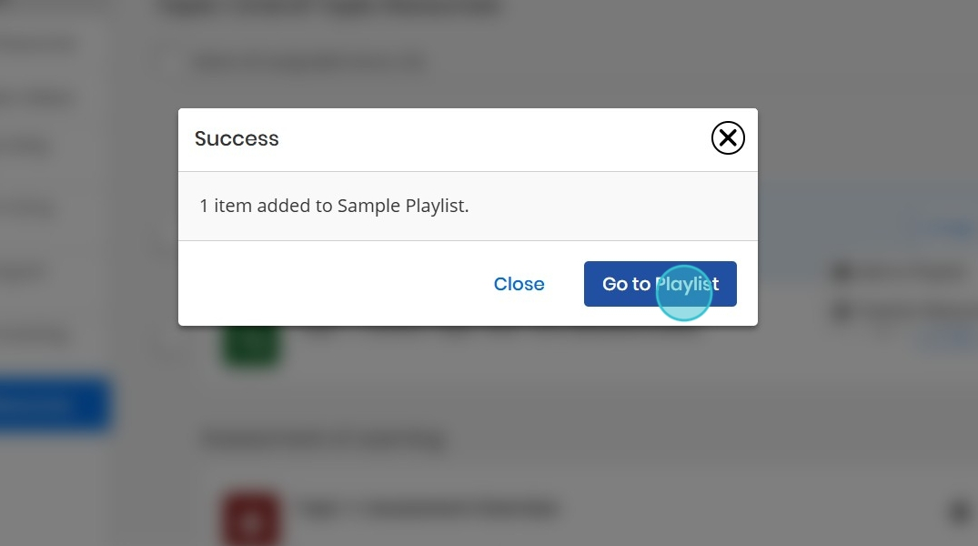
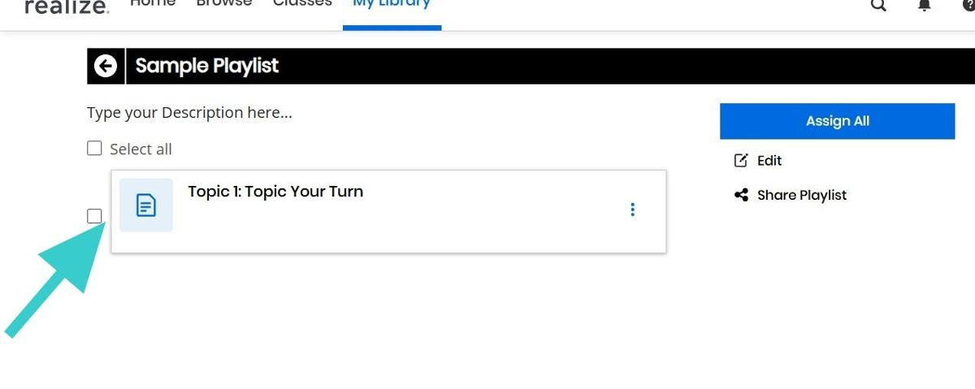

7. A pop-up will appear to confirm your activity was added to the Playlist. If you want to view your
Playlist, click on Go to Playlist.
8. The new activity will appear on your Playlist.
Thank you for viewing these Steps to Success! We hope you found this tutorial helpful. Be sure to check out My Savvas Training for more tutorials and tips.
Savvas.com
800-848-9500

